Slide 1
Traumatic Brain injury in the united states
A SERIOUS PUBLIC HEALTH ISSUE
Notes:
Press F5 to begin slide show. Video clip is in slide #9.

Slide 2
ANNUAL ESTIMATES
1.7 MILLION TBI-related emergency department visits, hospitalization, and deaths
52,000 DEATHS
TBI contributes to 30.5% of all injury-related deaths in the US

Slide 3
tbi RATES vary by age and sex
HIGHEST IN
Children 0 through 4 years old
Adolescents 15 through 19 years old
Males

Slide 4
TRAUMATIC BRAIN INJURY causes
FALLS ARE THE LEADING CAUSE OF TBI
HIGHEST IN
Children 0 through 4 years old
Adults 75 years old or greater
MOTOR VEHICLE ACCIDENTS ARE THE LEADING CAUSE OF TBI DEATH
HIGHEST IN
Adults 20 through 24 years old

Slide 5
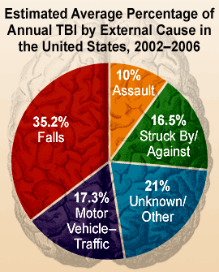
TRAUMATIC BRAIN INJURY causes

Slide 6
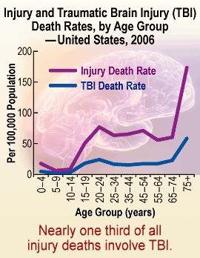
TRAUMATIC BRAIN INJURY deaths

Slide 7
Reducing Severe Traumatic Brain Injury in the US
Public health grand rounds presented September 20th, 2011, at the Centers for Disease Control and Prevention in Atlanta, GA

Slide 8
Images courtesy
Centers for Disease Control and Prevention

